Slide 1
DX-Ball
Team 111
李承霖
林以謙
鄭昕

Slide 2
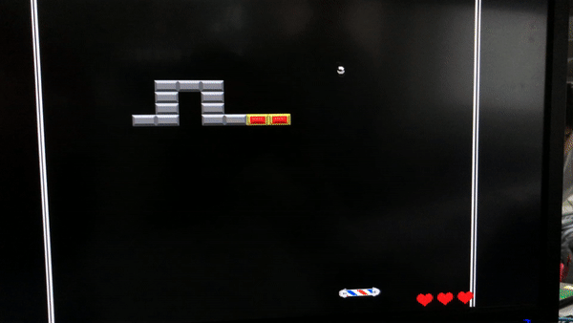
Introduction
Hit the bricks
Items hidden in bricks have special functions

Slide 3
Introduction Bricks
Grey Brick
Life = 1
Blue Brick
Life = 2
Shine Brick
Life = 3
Invisible Brick
Life = 4

Slide 4
Introduction Platforms
Football
Size = 32 pixels
Spinner
Size = 64 pixels
Neon
Size = 128 pixels
Space Ship
Size = 256 pixels

Slide 5








Introduction Gadgets
Ball Shrink
Fire Ball
Ball Enlarge
Platform Shrink
Ball Slow
Platform Enlarge
Ball Fast
Platform Grab

Slide 6



Usage
Use laser to move right or left
Move laser down to trigger ball

Slide 7
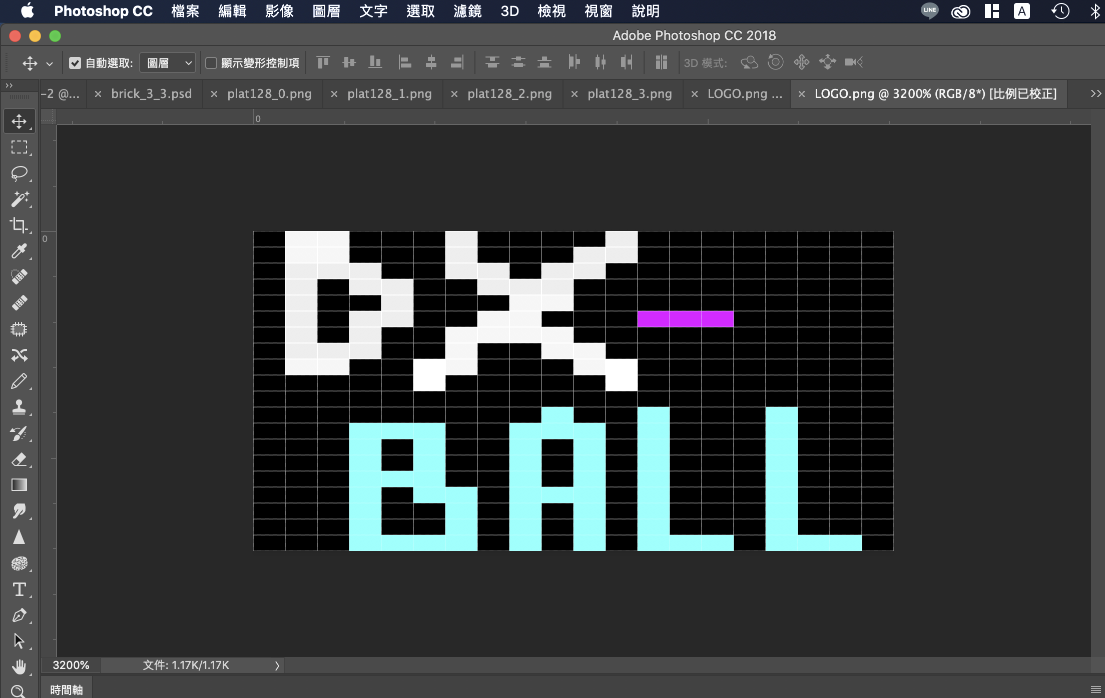
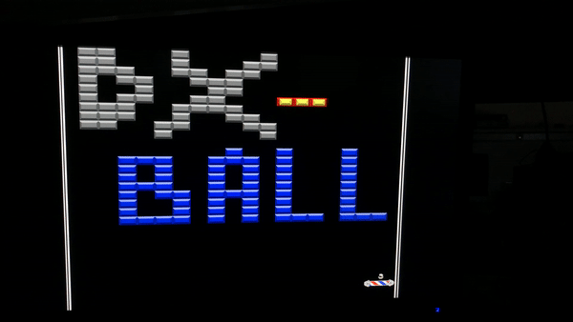
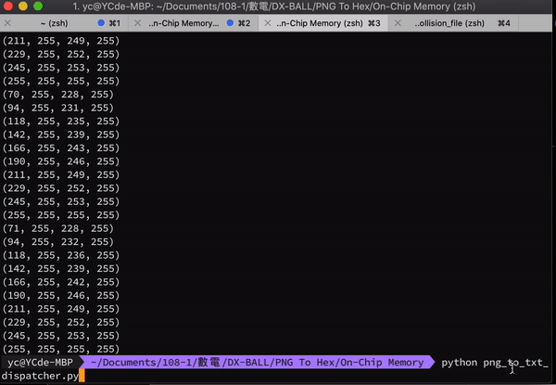
Map Description and Creation

Slide 8
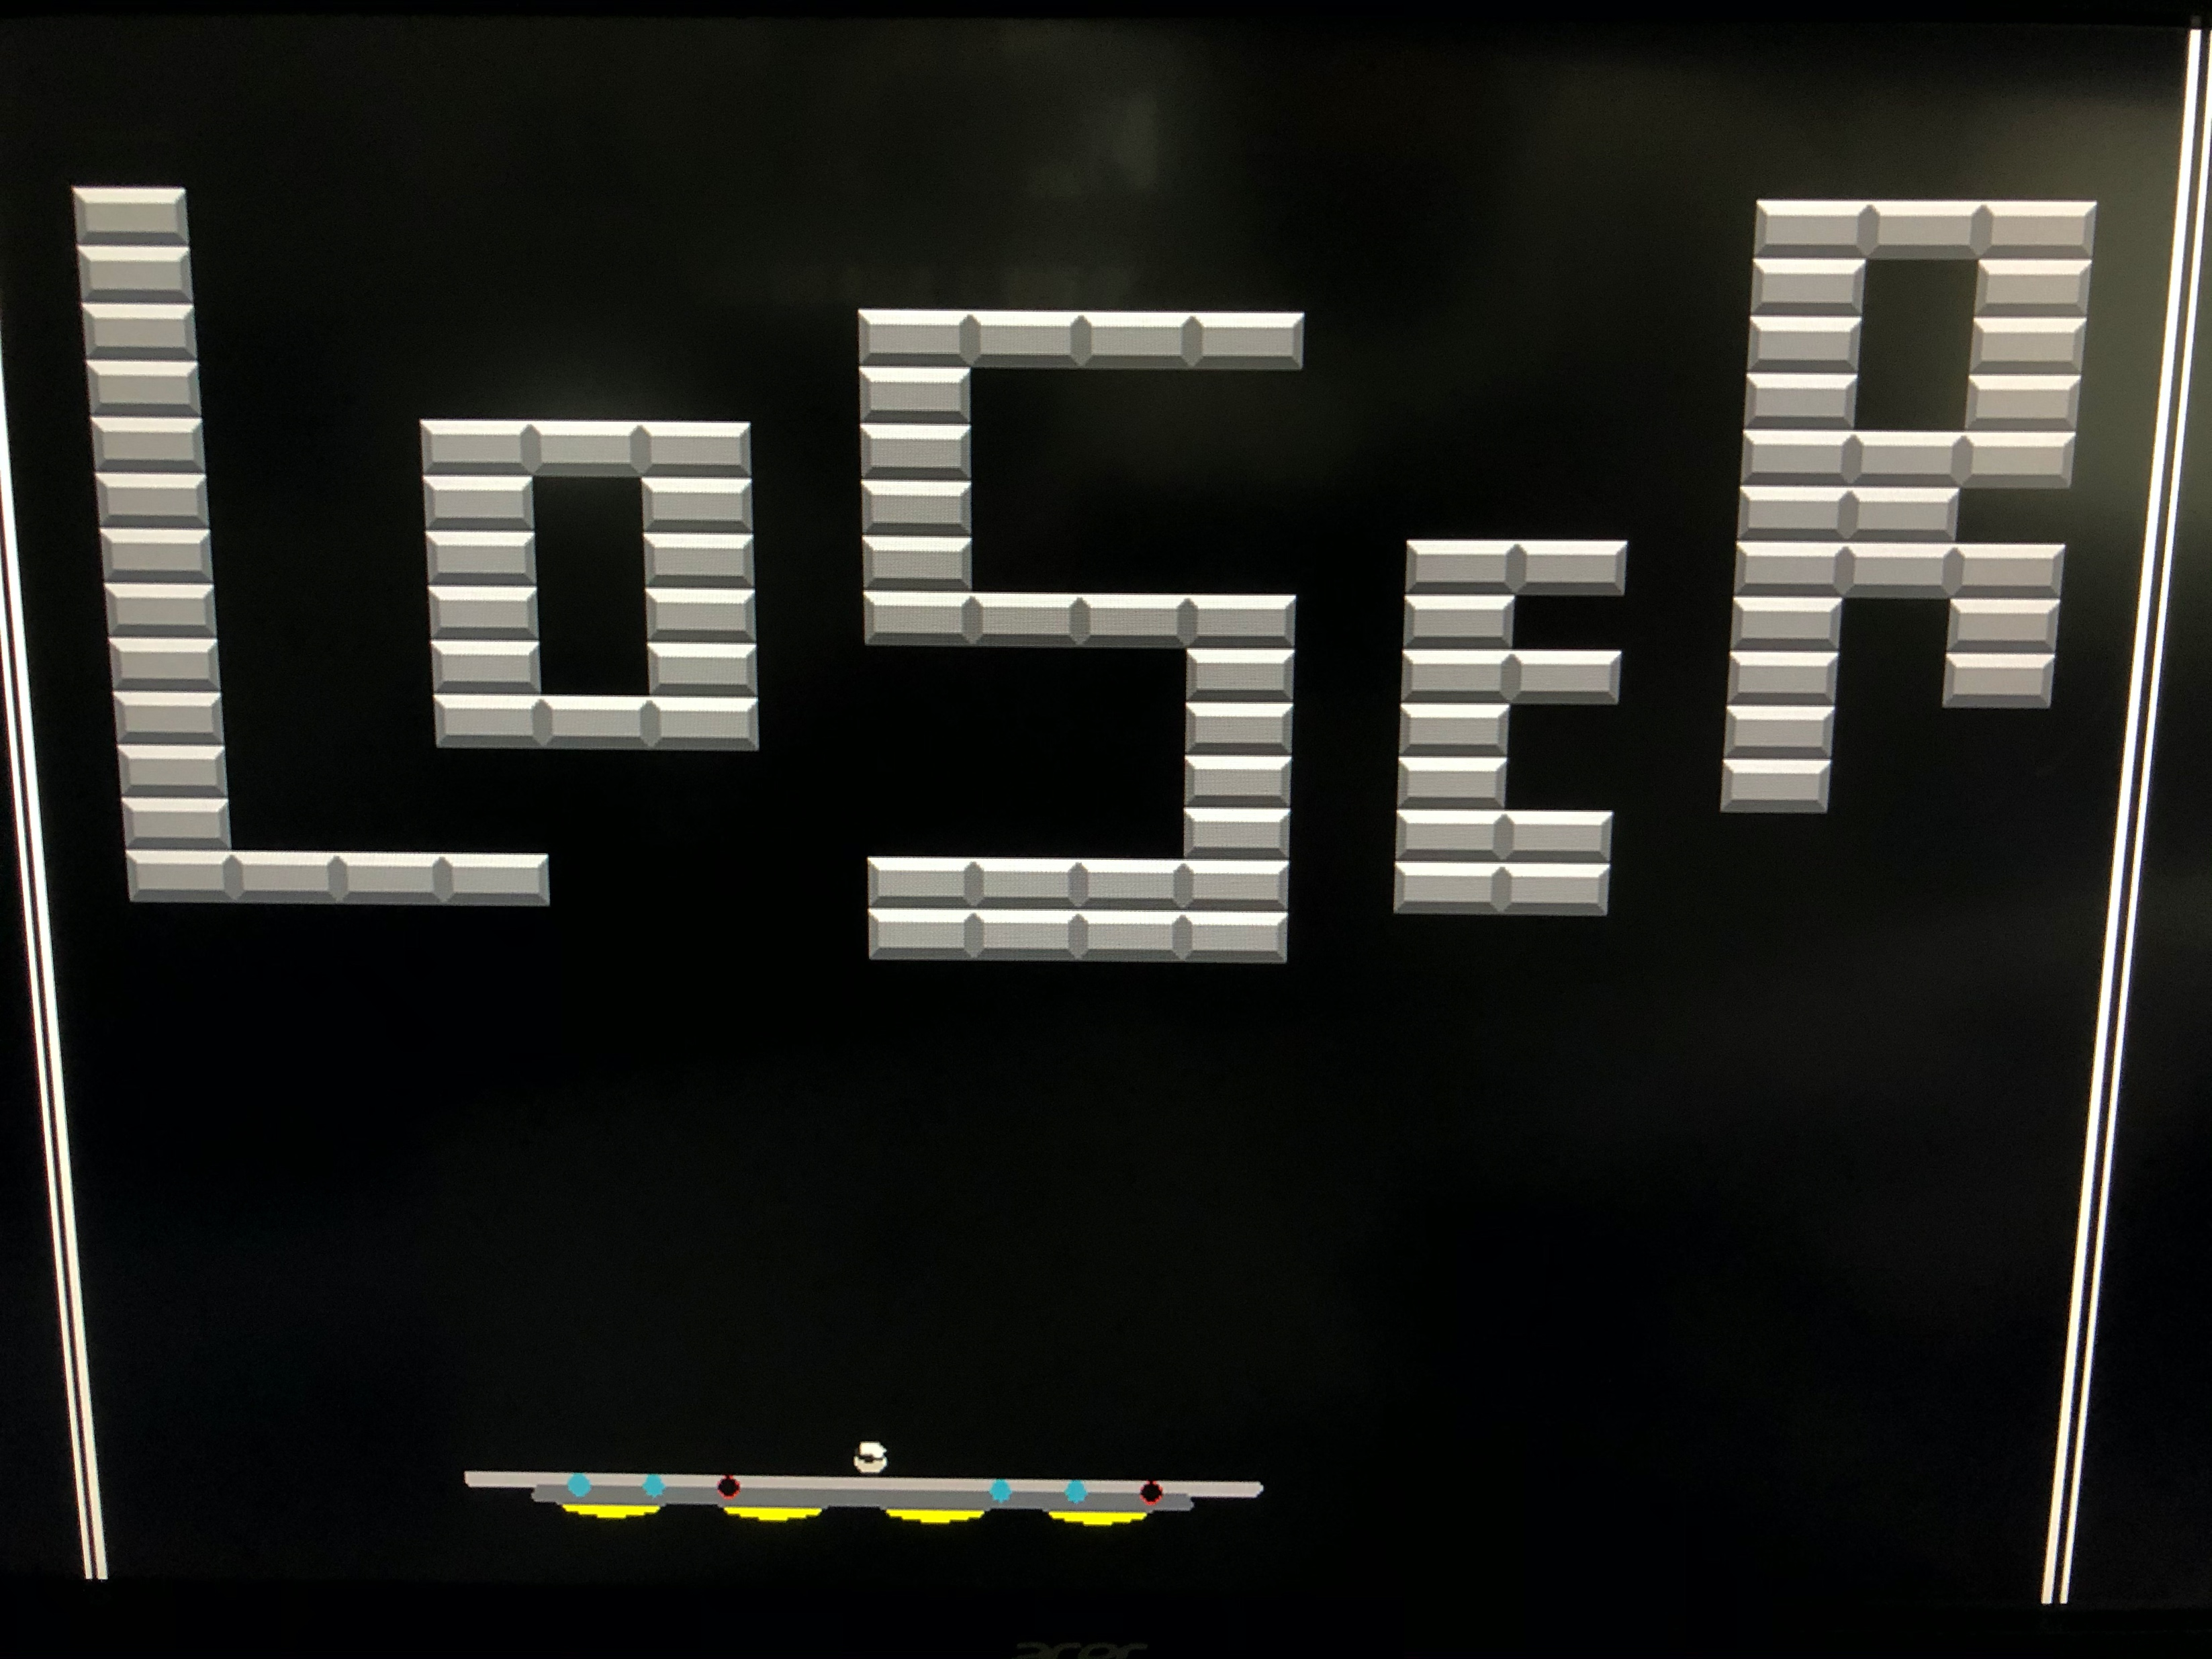
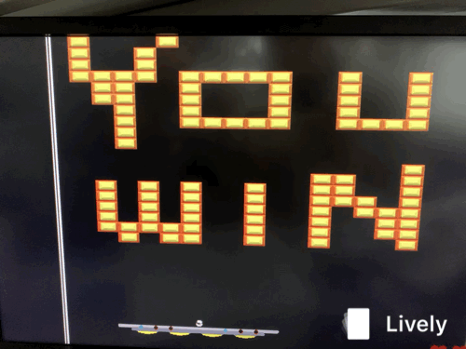
End Game

Slide 9
Hardware Architecture
D5M
Camera
Module
Game
Control
Color
Mapper
VGA
FPGA

Slide 10
DEMO TIME

